Slide 1

Department of ICT
B.E Sem : II (ICT) (MU)
Subject Name: MAVC
Unit title:
Vector Space
Subject name : MAVC
Instructor:
Prof. Foram

Slide 2
Introduction
In this chapter ,we will study
Vector Space
Linear independence of vectors
Basis

Slide 3
Vector Space
DEFINITION:
Let V be a non-empty set of Objects. If the following axioms are satisfied by all objects u,v,w in V and all scalars k then V is called vector space. (For given operations)
1.
If u and v are objects in V then u + v is in V
2.
u + v = v + u
3.
u + (v + w) = ( u + v ) + w
4.
There is an object 0 in V, such that 0 + u = u + 0 = u for all u in V.
5.
For each object u in V, there exist an object -u in V, such that u + (-u) = 0.

Slide 4
DEFINITION:
6.
If k is any scalar and u is an object in V, then ku is in V.
7.
k(u + v) = ku + kv
8.
If k1, k2are scalars and u is an object in V, then ( k1+ k2) u = k1u + k2u.
9.
k1( k2u) = (k1 k2) u
10.
1 u = u

Slide 5
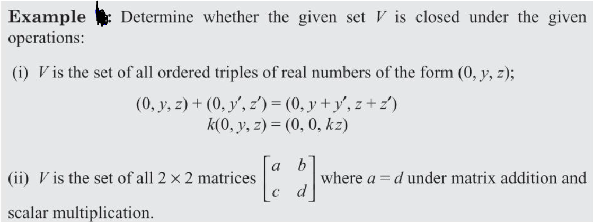
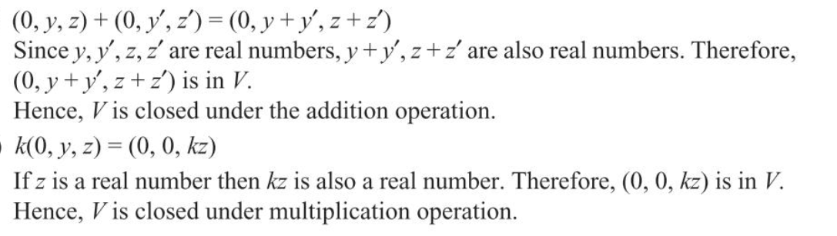
(i)

Slide 6
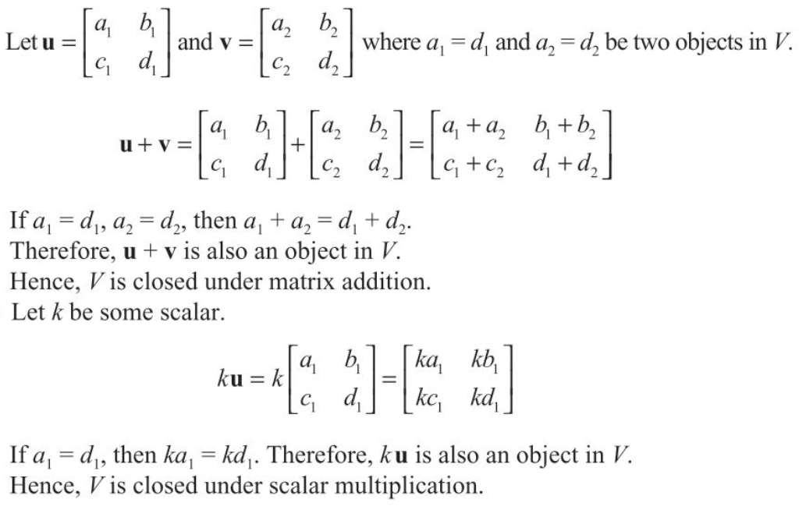
(ii)

Slide 7
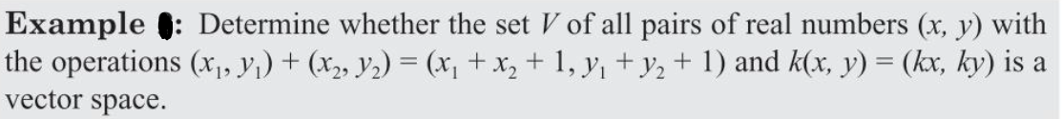

Slide 8
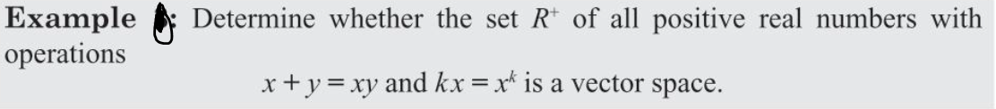
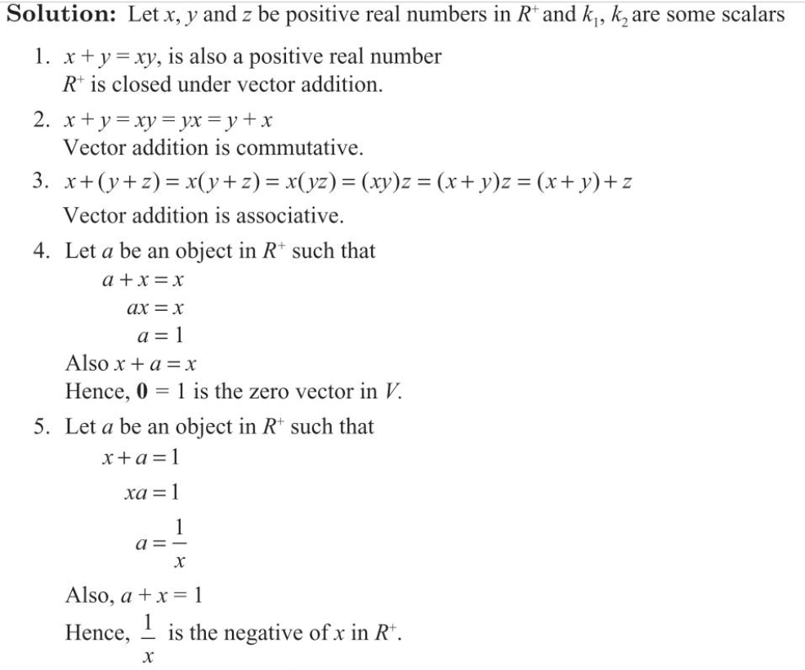

Slide 9
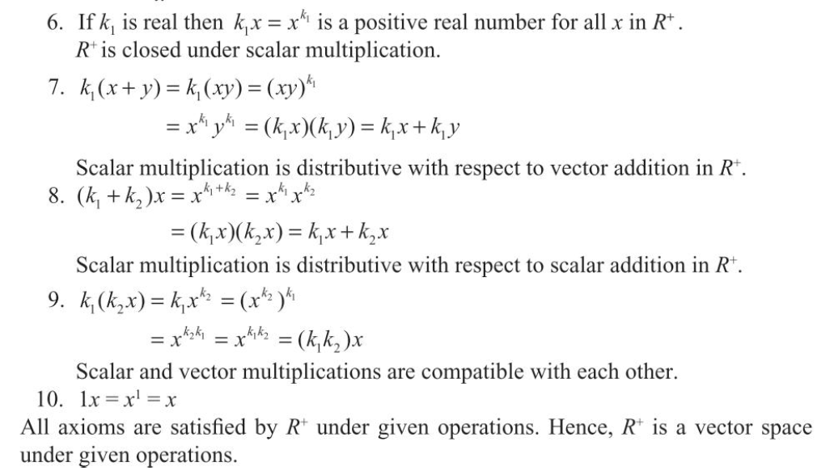

Slide 10
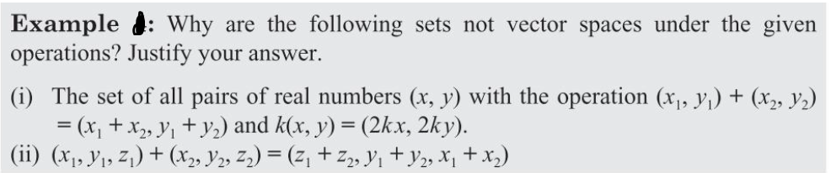

Slide 11
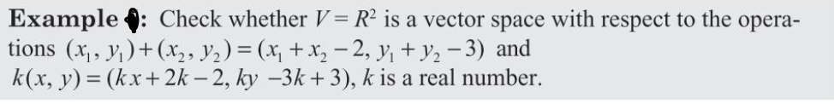

Slide 12
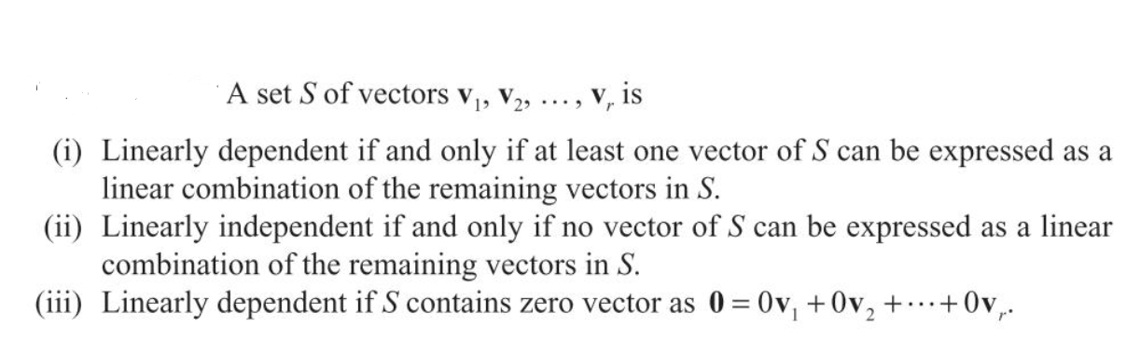
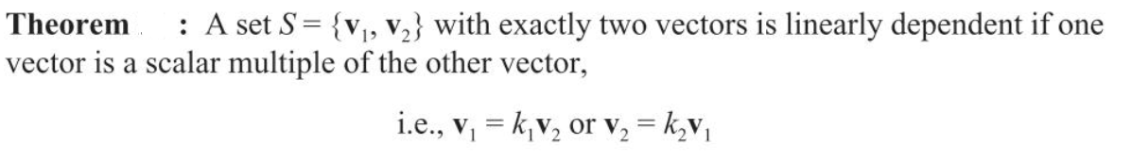
Linear Independence of Vectors

Slide 13
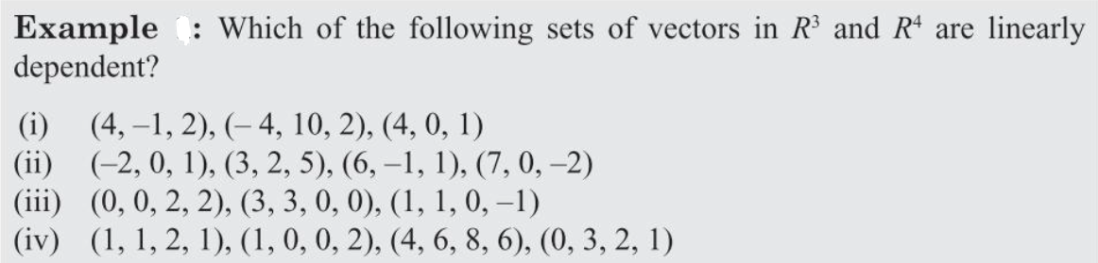
Linear Independence of Vectors

Slide 14
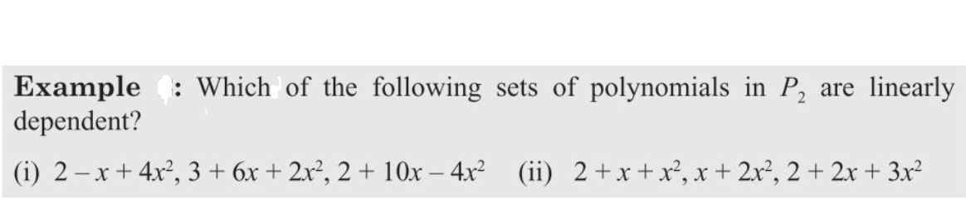
Linear Independence of Vectors

Slide 15
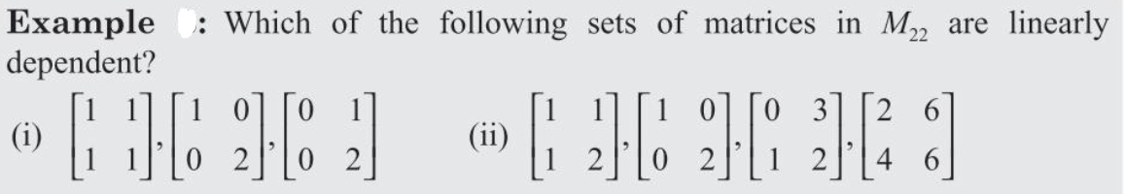
Linear Independence of Vectors

Slide 16
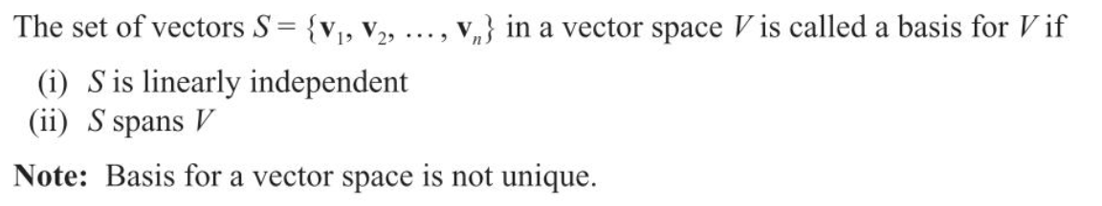
Basis

Slide 17
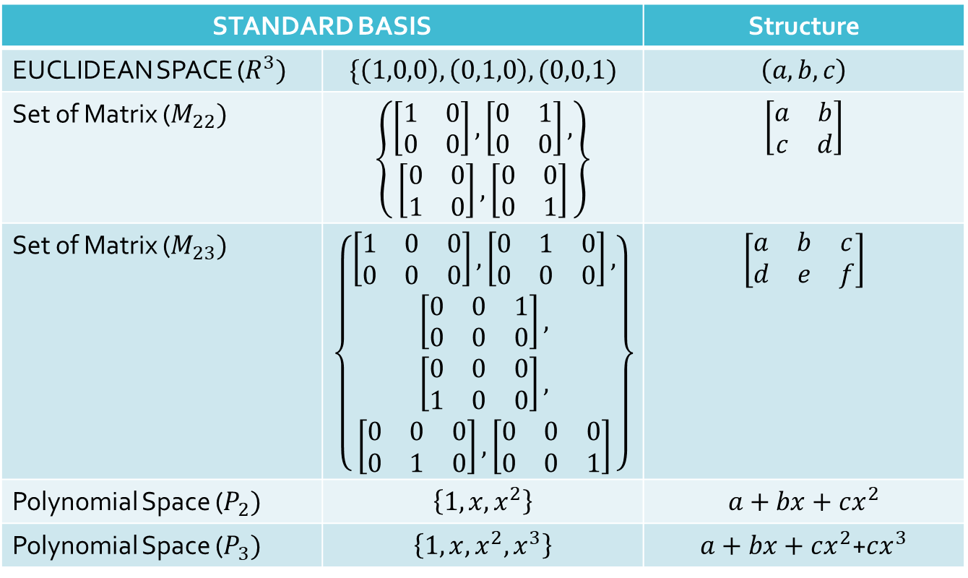
Basis
STANDARD BASIS |  | Structure
EUCLIDEAN SPACE ($R^{3})$ | $$\{\left(1,0,0\right),\left(0,1,0\right),(0,0,1)$$ | $$\left(a,b,c\right)$$
Set of Matrix ($M_{22})$ | $$\left\{\begin{aligned}\left[\begin{matrix}1 & 0 \\ 0 & 0\end{matrix}\right],\left[\begin{matrix}0 & 1 \\ 0 & 0\end{matrix}\right], \\ \left[\begin{matrix}0 & 0 \\ 1 & 0\end{matrix}\right],\left[\begin{matrix}0 & 0 \\ 0 & 1\end{matrix}\right]\end{aligned}\right\}$$ | $$\left[\begin{matrix}a & b \\ c & d\end{matrix}\right]$$
Set of Matrix ($M_{23})$ | $$\left\{\begin{aligned}\begin{aligned}\left[\begin{matrix}1 & 0 & 0 \\ 0 & 0 & 0\end{matrix}\right],\left[\begin{matrix}0 & 1 & 0 \\ 0 & 0 & 0\end{matrix}\right], \\ \left[\begin{matrix}0 & 0 & 1 \\ 0 & 0 & 0\end{matrix}\right],\end{aligned} \\ \begin{aligned}\left[\begin{matrix}0 & 0 & 0 \\ 1 & 0 & 0\end{matrix}\right], \\ \left[\begin{matrix}0 & 0 & 0 \\ 0 & 1 & 0\end{matrix}\right],\left[\begin{matrix}0 & 0 & 0 \\ 0 & 0 & 1\end{matrix}\right]\end{aligned}\end{aligned}\right\}$$ | $$\left[\begin{matrix}a & b & c \\ d & e & f\end{matrix}\right]$$
Polynomial Space ($P_{2})$ | $$\left\{1,x,x^{2}\right\}$$ | $$a+bx+cx^{2}$$
Polynomial Space ($P_{3})$ | $$\left\{1,x,x^{2},x^{3}\right\}$$ | $a+bx+cx^{2}$+$cx^{3}$

Slide 18
Basis

Slide 19
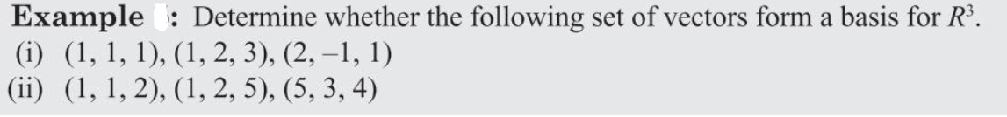
Basis

Slide 20
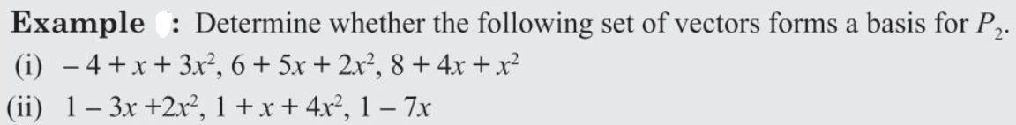
Basis

Slide 21
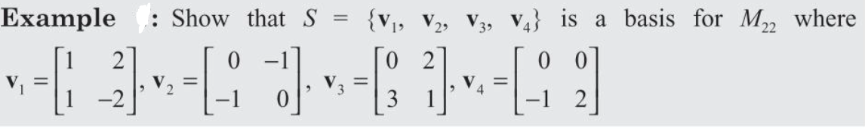
Basis

Slide 22
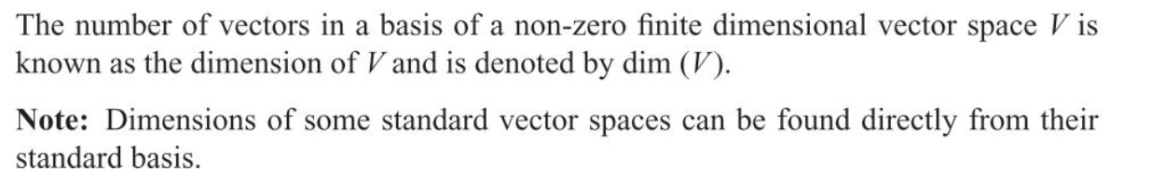
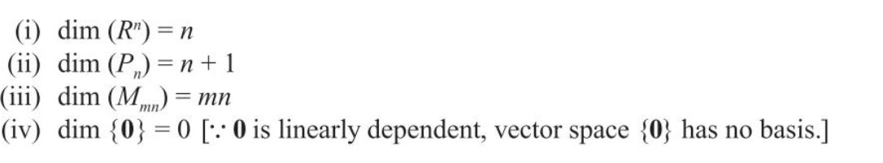
Dimension

Slide 23
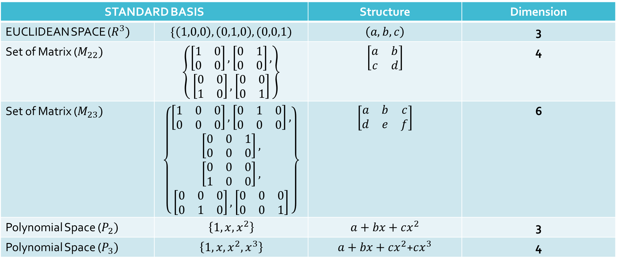
Dimension
STANDARD BASIS |  | Structure | Dimension
EUCLIDEAN SPACE ($R^{3})$ | $$\{\left(1,0,0\right),\left(0,1,0\right),(0,0,1)$$ | $$\left(a,b,c\right)$$ | 3
Set of Matrix ($M_{22})$ | $$\left\{\begin{aligned}\left[\begin{matrix}1 & 0 \\ 0 & 0\end{matrix}\right],\left[\begin{matrix}0 & 1 \\ 0 & 0\end{matrix}\right], \\ \left[\begin{matrix}0 & 0 \\ 1 & 0\end{matrix}\right],\left[\begin{matrix}0 & 0 \\ 0 & 1\end{matrix}\right]\end{aligned}\right\}$$ | $$\left[\begin{matrix}a & b \\ c & d\end{matrix}\right]$$ | 4
Set of Matrix ($M_{23})$ | $$\left\{\begin{aligned}\begin{aligned}\left[\begin{matrix}1 & 0 & 0 \\ 0 & 0 & 0\end{matrix}\right],\left[\begin{matrix}0 & 1 & 0 \\ 0 & 0 & 0\end{matrix}\right], \\ \left[\begin{matrix}0 & 0 & 1 \\ 0 & 0 & 0\end{matrix}\right],\end{aligned} \\ \begin{aligned}\left[\begin{matrix}0 & 0 & 0 \\ 1 & 0 & 0\end{matrix}\right], \\ \left[\begin{matrix}0 & 0 & 0 \\ 0 & 1 & 0\end{matrix}\right],\left[\begin{matrix}0 & 0 & 0 \\ 0 & 0 & 1\end{matrix}\right]\end{aligned}\end{aligned}\right\}$$ | $$\left[\begin{matrix}a & b & c \\ d & e & f\end{matrix}\right]$$ | 6
Polynomial Space ($P_{2})$ | $$\left\{1,x,x^{2}\right\}$$ | $$a+bx+cx^{2}$$ | 3
Polynomial Space ($P_{3})$ | $$\left\{1,x,x^{2},x^{3}\right\}$$ | $a+bx+cx^{2}$+$cx^{3}$ | 4

